Slide 1


VOLTAMAC HOME HEALTH SERVICES: OVERVIEW
Simply Reliable

Slide 2




CORE SERVICES
Founded in 2015
CLINICAL TRIALS
Data Collection
Expertise in Remote Patient Monitoring, Biometric Data Collection for Clinical Trials, Skilled Nursing, Memory Care
TELEHEALTH
Founder has experience in health IT, management operations
Headquarters in Hackensack, NJ
SKILLED NURSING & TRANSITION CARE
-
PHYSICAL THERAPY &
WORKERS
COMPENSATION
Quality Patient Care; Qualified Staff; Statewide Coverage
Quality Industry Partnerships & Collaboration
CHRONIC & MEMORY
CARE

Slide 3
APPLICATIONS FOR REMOTE PATIENT MONITORING
Chronic care management
(Cardiac [Congestive Heart Failure, CAD],
Diabetes, and Pulmonary patients [COPD, Asthma])
Obesity and weight management
Post-event rehabilitation / Post-surgical
Nursing home, elderly care, disabled programs
Memory & Chronic Care
Consumer-based self-care management
Diagnostic monitoring (ex: cardiac events)
Readmission programs

Slide 4
MAJOR VHHS TELEHEALTH APPLICATION FEATURES
Remote Patient Monitoring Dashboard (Glucose, Blood Pressure, Weight, Pulse Oximeter, Temperature, Activity, CGM, Spirometry, ECG)
Visual and messaging mechanism for raising alerts based on exceeding configurable alert conditions based on remote biometric measurements
Secure messaging for communicating with patients
Video Consultations
Collection of qualitative information from patient using customizable digital surveys
Tabular and charting reports for reviewing patient data for diagnostic and analytic purposes.

Slide 5









DATA FLOW
Bluetooth Wireless Devices
Cloud-to-cloud
Pulse Oximeter
ECG
Temperature
Activity /
Wearables
Mobile Device
Weight
Weight
Blood Pressure
Wireless Hub
3rd Party
Apps
Glucose
Peak Flow

Slide 6
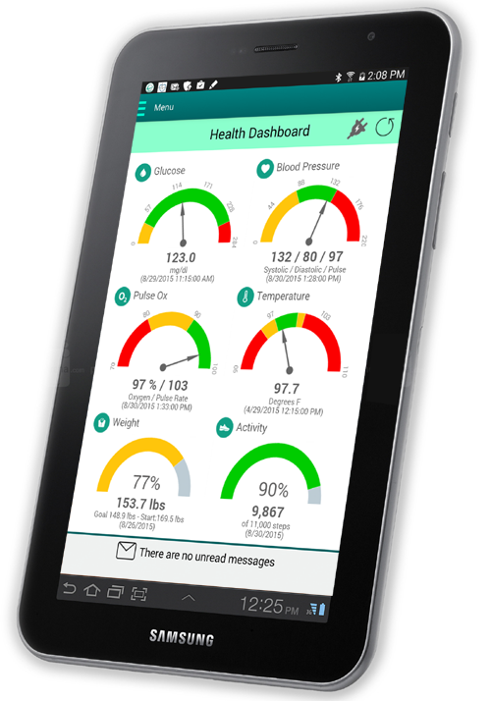
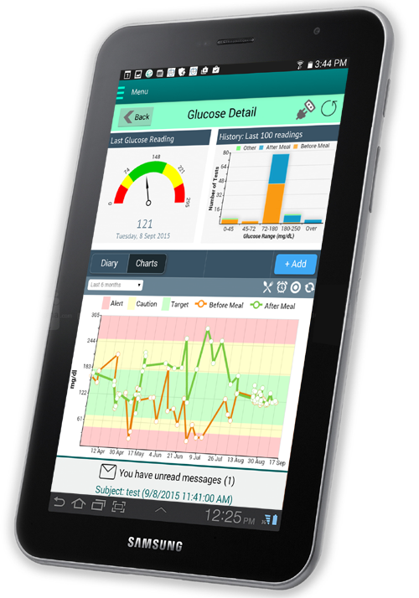
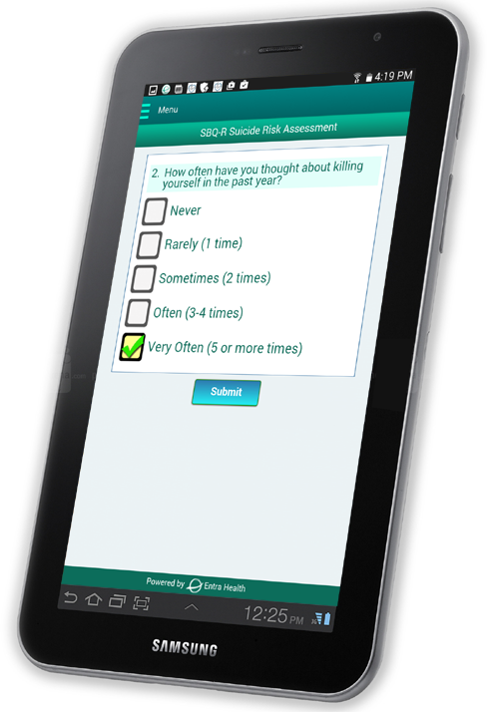

PRODUCTS - PATIENT TABLET
(SURVEYS & TELECONSULTS)

Slide 7
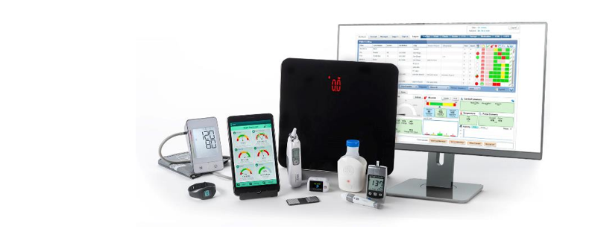
VOLTAMAC TELEHEALTH KITS

Slide 8
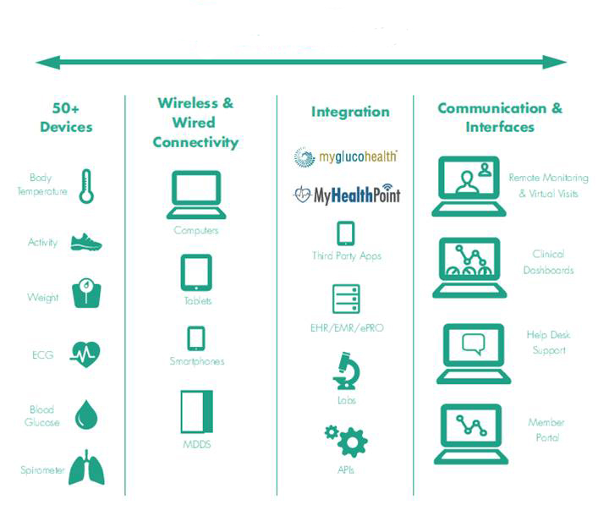
VOLTAMAC TELEHEALTH INTEGRATION
Admin Utilities

Slide 9

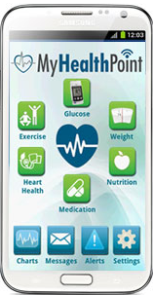


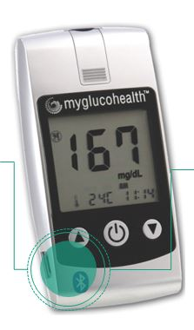
VOLTAMAC HOME HEALTH SERVICES
BETTER HEALTH IN A WIRELESS WORLD

Slide 10
CONNECT WITH US
Voltamac Home Health Services
140 Prospect Avenue, Suite 4N
Hackensack, NJ 07601
Tel: 201-428-9090 (Cell): 917-612-6447
Fax: 888-721-0888
Email: inquiries@vhhscare.com
URL: www.vhhscare.com

